Slide 1

MAVlink Protocol
Overview, Security Threats & Possible Solutions
Based on Micro Air Vehicle Link (MAVlink) A Survey
Also used https://mavlink.io/en/
Edited by Itay Ben Moshe, Ariel University 2020-2021

Slide 2
Introduction
MAVLink is a communication protocol for UAV systems, which specifies a comprehensive set of messages exchanged between unmanned systems and ground stations (GCS). The protocol is used in major autopilot systems, mainly ArduPilot¹ and PX4.
In this presentation we will discuss the communication characteristics of the protocol and the types of messages transmitted, differences in versions, exploitation of vulnerabilities in favor of possible attacks and also ways of defense and countermeasures from them.
ArduPilot¹ Project provides an open source autopilot software system, which is capable of controlling almost any vehicle system imaginable including drones, and according to the developers, the software installed in over 1,000,000 vehicles world-wide, and it’s a deeply tested and trusted autopilot system.

Slide 3
MAVLink Messages Serialization
MAVLink is designed as a Marshaling library (translating a data structure or object state into a format that can be stored), which means that it serializes messages of the states of the system and the commands that it has to execute into a specific binary format.
The binary serialization nature of the MAVLink protocol makes it lightweight as it has minimal overhead as compared to other serialization techniques such as XML or JSON.
As of today, the MAVLink protocol has two versions MAVLink 1.0 and MAVLink 2.0.
while version 2.0. contains fields and additional information, which is reflected, among other things, in the expanded header size of the messages.

Slide 4
Communication & Transport Protocols
MAVLink protocol defines the mechanism on the structure of messages and how to serialize them at the application layer. These messages are then forwarded to the lower layers (i.e., transport layer, physical layer) to be transmitted to the network.
The advantage of the MAVLink protocol is that it supports different types of transport layers thanks to its lightweight structure, including network interface, which is typically typically WiFi or Ethernet, and stream the MAVLink messages through IP Networks.
The autopilot running the MAVLink protocol typically supports both UDP, for real time and loss tolerant message streaming, and also TCP connections at the transport layer between the ground station and the drone, depending on the reliability level required by the application

Slide 5
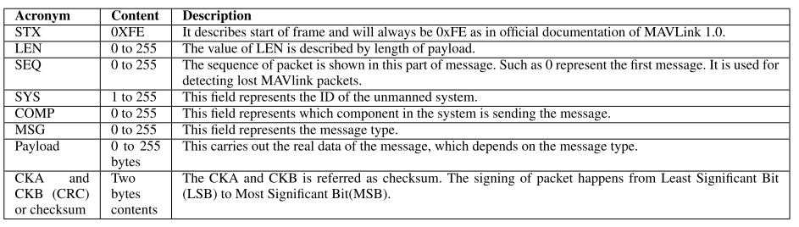

Message Types & Structures (MAVLink 1.0)
MAVLink messages are binary-serialized messages, which means that the content of the message is transformed into a sequence of bytes to be transmitted through the network, and the receiver of the serialized message performs its deserialization in the opposite direction to reconstitute the original message sent.
The MAVLink 1.0 protocol header contains eight important fields as follows:

Slide 6

Common MAVLink Messages Types
The HEARTBEAT message is the most important message in MAVLink, because it indicates that the vehicle system is present and active. The unmanned system periodically sends the heartbeat message (in general every second) to the GCS to inform the that it is active.
The HEARTBEAT message structure is depicted is as follows
It will be interesting to see how we can take advantage of the vitality of the HEARTBEAT message and the fact that it is sent in every fixed time unit, for the purpose of attacking UAV
Due to the great importance of the HEARTBEAT message , we will go over its structure and see examples from it.
type field indicates the type of the Micro Aerial Vehicle, for example MAV_TYPE_HELICOPTER = 4 if we're dealing with a helicopter.
autopilot field indicates the type of autopilot, for example MAV_AUTOPILOT_ARDUPILOTMEGA = 3 indicates ArduPilot autopilot
base_mode field indicates different operation modes, and it's very important to understand in order to correctly parse the heartbeat message and extract useful information out of it. For example Flag = 4 means that the autonomous mode (AUTO) is enabled. This means that the unmanned system is operating autonomously by navigating to the goal waypoints sent to it from the ground station, while Flag = 128 the system is in armed state, which means that motors are enabled/running and can start the fly.
The custom mode indicates autopilot specific flags that are interpreted in addition to the base mode, and it's used in heartbeat message parsing to determine the flight modes of the autopilot system. For example 9 for LAND mode, which will force the UAV system to land to the ground.
system_status field represents a flag that indicates the system state, for example system_status = 6 this means an emergency situation where the unmanned system lost control over some parts and is in distress situation. The system may have already been crashed
The system status message has a Message ID equal to 1 and is composed of data about the onboard control sensors embedded into the unmanned system and specifies which of these sensors are enabled/disabled and which sensors are operating or having errors.
It also carries out data about the battery status and the remaining voltage, which is useful to track the battery level of the unmanned system, and it provides information about the communication errors and the ratio of dropped packets in the communication link
The global positioning message has an id equal to 33 and represents the filtered GPS coordinate provided by the Global Positioning sensor
When it comes to status messages, there is of course the possibility on the part of the attacker to sabotage the messages sent by the UAV to its operator, thereby causing it to be disrupted and even crashed.
We'll see how we can take advantage of this. Now let’s see the command messages.
MAVLink defines several types of messages, which are identified by their Message ID.
We can categorize MAVLink messages into two classes. the first one is State messages.
These messages are sent from the UAV system to the operator and contain information about the state of the system, such as its ID, location, velocity etc
The second is Command messages
They are sent by the GCS to the UAV system to execute some actions or missions by the autopilot. For example, the ground station can send a command to a drone to takeoff.
Note, there are large number of MAVLink messages, we'll focus most relevant state and command messages used in common implementations of autopilots

Slide 7
Common MAVLink Messages Types
There are several command messages in MAVLink that give the ability to request the unmanned system to perform certain actions. We'll focus few of them.
The COMMAND_LONG is a multi-purpose command that allows sending different types of commands depending on the command type of the message and its parameters.
The mission item command has a Message ID equal to 39 and allows to send a waypoint to an unmanned system so that it navigates autonomously to that specific waypoint

Slide 8
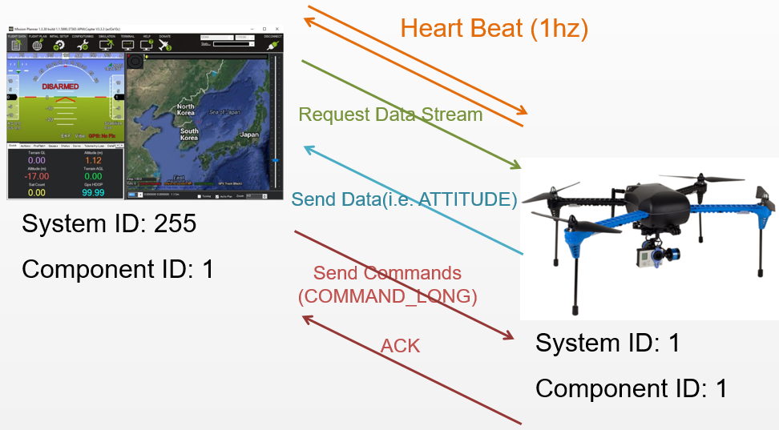
Messages Flows Example
Once a connection is opened each device (aka “System”) sends the HEARTBEAT message at 1hz
The ground station or companion computer requests the data it wants (and the rate) by sending messages of the following types
REQUEST_DATA_STREAM supports setting the rate of groups of messages
COMMAND_LONG containing a SET_MESSAGE_INTERVAL command provides precise control of which messages are sent (and their rate) but is only supported on ArduPilot 4.0 and higher
Ground station or companion computer send commands to the vehicle. Details of the supported commands are here for copter and plane

Slide 9
Security Issues Of MAVLink
The article examined various aspects of security issues at MAVLink protocol, including terms of confidentiality, integrity, availability, authentication, non-repudiation, authorization, and privacy in order to secure communications.
For the purpose of the discussion and research, we will present a number of important aspects that are essential for the secure and proper communication between the UAV and the GCS.
Confidentiality: An essential requirement to guarantee private data exchange between entities
Authentication: The authentication of the UAV by the GCS is highly critical to make sure the GCS is controlling an authorized drone, not a fake one. Also, it is essential that GCS can also be authenticated so that an unmanned system does not send its state or accept commands from a hacked/fake ground station
Integrity: It is mandatory to secure communications between GCSs and UAVs by ensuring the integrity of exchanged data
Availability: The communication between UAVs and GCSs should be available, as well as the information itself is always available when needed or requested, even if a fault has occurred on the UAV system or an attacker tries to jam the UAV/GCS channel.

Slide 10
Availability Attacks, Confidentiality
The article touched on a wide range of exploitation of vulnerabilities in the protocol in favor of attacks and disruption of the communication between the UAV and the GCS. We will discuss some of them, Confidentiality first.
Due to the lack of encrypted connections, an attacker listens to the communication happening between UAVs and GCS, eavesdrops on the information exchanged between UAVs and GCS directly from the open environment.
Alongside this, the MAVLink uses the System IDs to identify the drone which sends or is expected to receive the messages. System ID is sent in clear within the unencrypted MAVLink header.
Note, while these are inactive attacks, it is sometimes essential to gather intelligence before the attack itself, along with the loss of private information exchanged between the UAV and the person operating it, which can be worth a great deal of capital.

Slide 11
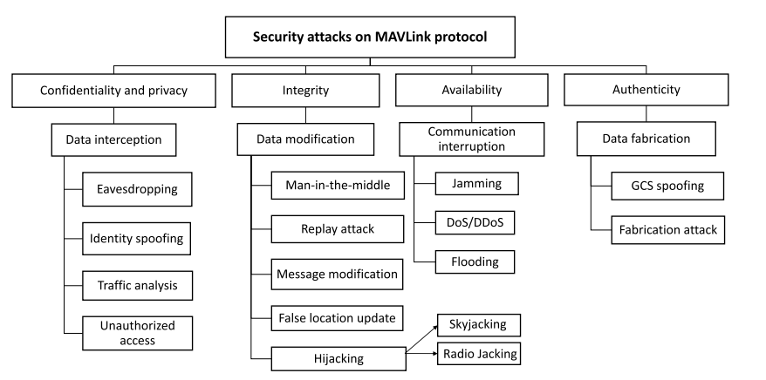
Availability Attacks, Integrity and Availability
In MAVLink communication protocol, messages are sent in plain text which represents vulnerability and a threat to network security, and a MITM attack can be successfully established in the channel. The attacker is located between UAVs and GCS and listen to the exchanged communications.
Moreover, and in similar to EvilTwin and DOS attacks on WiFi AP, we can use open source software such as airplay-ng to force disconnecting the user from the drone by injecting de-authentication messages. Since the drone does not authenticate users, an hacker may easily connect to it and take control over the device as soon as the WIFI connection is established

Slide 12
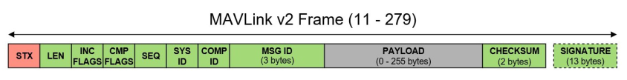
Solutions & Countermeasures, MAVLink 2.0 version
Although there are a number of security gaps in the protocol, efforts have been made to maximize and secure the protocol in a better way. Meanwhile, the MAVLink 2.0 version contains additional fields that give an extra shell for security.
MAVLink 2.0 uses an optional Signature field of 13 bytes to ensure that the link is tamper proof. This features significantly improve security aspects of the MAVLink 1.0 as it allows the authentication of the message and verifies that it originates from a trusted source. The message signature contain the following fields:
LinkID: one byte represents the ID of the link (channel) used to send the packet. A link or a channel can be WiFi or telemetry and can be combined. Every channel used to send data should have its own LinkID
Timestamp: it is encoded with 6 bytes in 10-microsecond units. It increases for every message sent over the channel. The timestamp is used to avoid replay attacks.
Signature: it is encoded in 6 bytes for the message and is calculated based on the complete message, timestamp, and the secret key, which share a symmetric key of 32 bytes stored on both ends, namely the autopilot, and the ground station or the MAVLink API.

Slide 13
Solutions & Countermeasures, Software/Hardware
Along with the existing enhancements to MAVLink 2.0, there are other security solutions, some software-based and some hardware-based.
Several embedded and hardware security solutions have been introduced to secure the MAVLink protocol, including cryptography functions, that used to encrypt and authenticate both commands and payload data communicated between the drone and the GCS. However, the hardware solution negatively affects system performance and power consumption due to the extra hardware weight. Keep in mind that one of the benefits of MAVLink is its simplicity and lightweight. We would like to preserve that.
Other software-related ideas also included forcing the drone to return to start position where it performed the takeoff in case of a malfunction in the UAV, or identifying information corruption and / or delaying the transmitted response.

Slide 14
Conclusion
MAVLink protocol is a lightweight protocol for communication with UAV systems, based binary-serialized messages.
We've discussed some of the MAVLink security requirements, threats, and possible solutions, while focusing on the attack characteristics and UAV protection options that are more common in the protocol, with the intention of deepening the knowledge and exploring additional ways and / or improving the existing situation.
Currently, it remains to examine the extent of the use of MAVLink and its assimilation in the more common UAVs on the market, and to conduct simulations to examine and implement the protocol.

